Slide 1

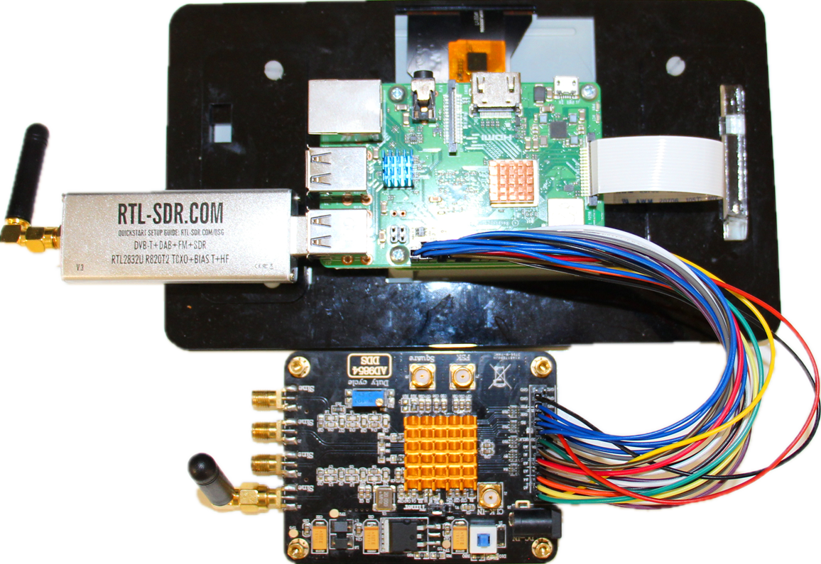
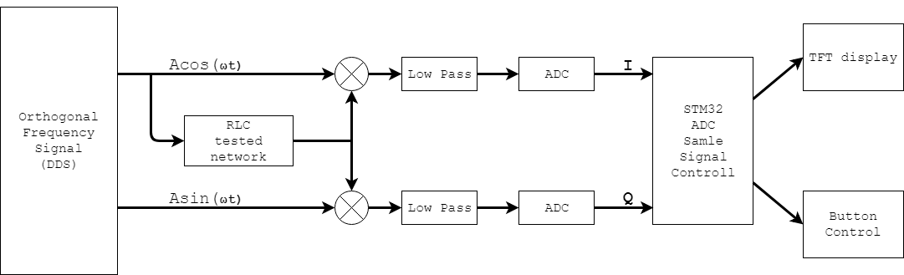
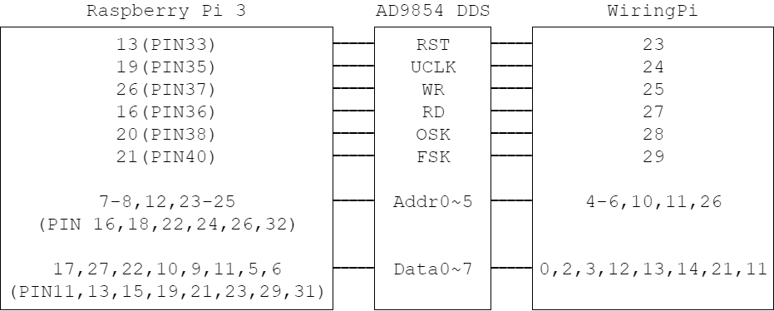
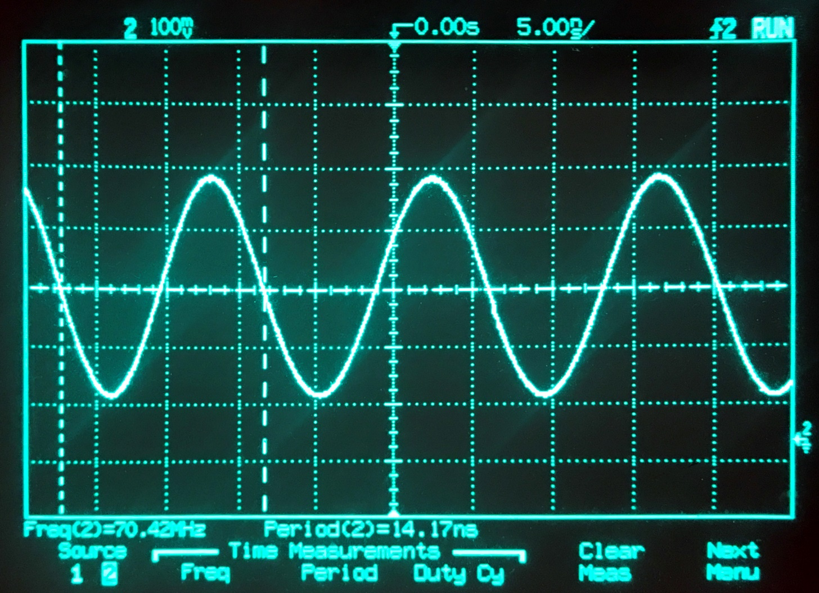
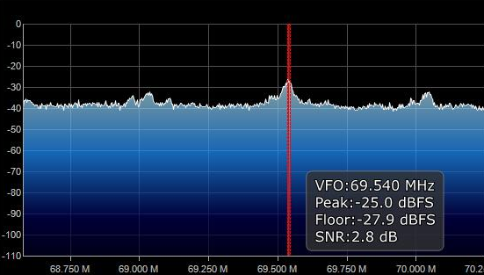
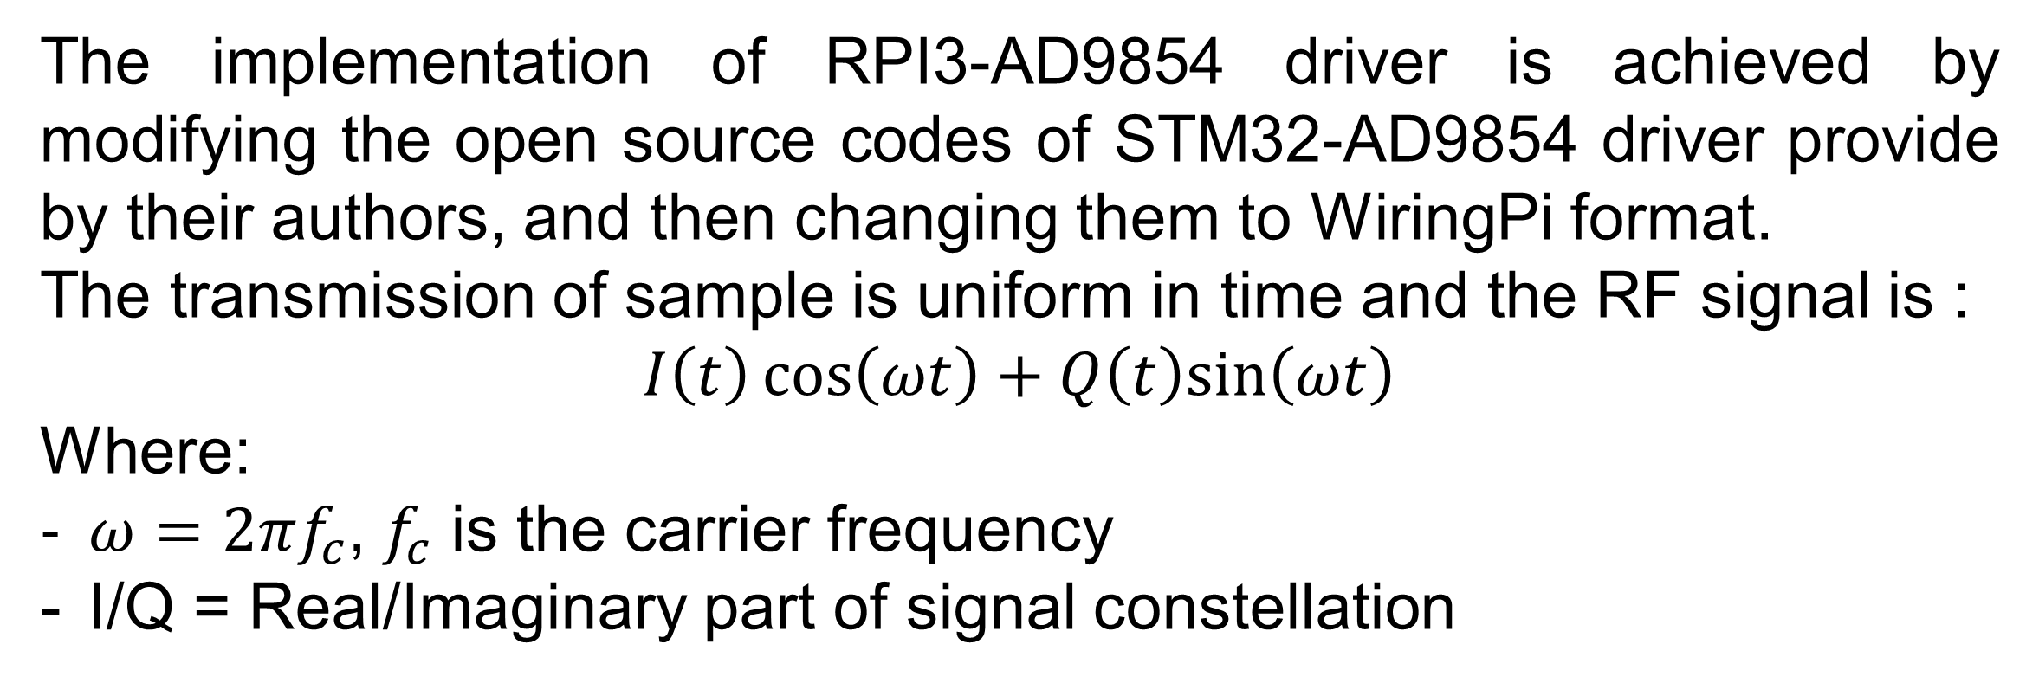
8th Conference on Engineering Students Individual Projects
CESIP
Oct 2018
Low Cost DDS Based Transceiver of Low VHF
Student: Zhenzhen Liu
Supervisor: Gerard Borg
Scope
Outcome
The project’s goals and requirements include:
Develop a low cost radio transmitter based on the AD9854 Direct Digital Synthesizer （DDS）.
Drive the AD9854 DDS with Raspberry Pi (RPI).
Program synced signals in C programming language.
Use version 3 RTL-SDR dongle as receiver.
The transceiver is of low Very High Frequency (VHF): 70Mhz.
The major challenge is that the compatibility of the components are unverified. There is no previous work combining the usage of Raspberry Pi and AD9854 DDS module.
Primary Achievements / Outcomes:
Able to drive AD9854 DDS directly through Raspberry Pi 3 B+.
Generation of various frequency RF signals on AD9854.
Program synced signals using WiringPi and C programming.
Signal reception using RTL-SDR on Linux and Windows.
Utilise RF amplifier to enhance transmitted signal and allow detection.
Previous Work
Existing applications on AD9854 DDS are such as Frequency Characteristic Tester, used for testing the amplitude-frequency characteristics and phase-frequency characteristics of networks.
Fig 1. Structural architecture for STM32 driven AD9854 based Frequency Tester
The principle is Zero-IF quadrature demodulation. The design uses the AD9854 DDS driven by STM32 microcontroller to produce sweep signal of 1MHz. to 40MHz via button control, with continuous sweep output of minimum step of 100kHz. [1]
Fig 3. Low Cost AD98654 DDS Based Transceiver of Low VHF
Another previous work is a signal generator based on AD9854 driven by AT98LS52.[2] The frequency, phase and amplitude of the output signal can be adjusted through the generator. The result shows that this combination is feasible and effective.
The Radio Frequency signal generated through AD9854 DDS presents as a stable sinewave approximately 70MHz with peak to peak voltage 0f 375.0 mV. For signal reception, RTL-SDR has been set up on Linux , with sampling rate 2.4GHz. The result is then verified through RTL-SDR with Airspy SDRSharp on Window 10. RF amplifier of 40dB gain can be used in assistance.
Methodology
Fig 2. GPIO Pinout for Raspberry Pi 3 B+ to drive AD9854 DDS
The implementation of RPI3-AD9854 driver is achieved by modifying the open source codes of STM32-AD9854 driver provide by their authors, and then changing them to WiringPi format.
The transmission of sample is uniform in time and the RF signal is :
$$I\left(t\right)\cos\left(ωt\right)+Q\left(t\right)sin⁡\left(ωt\right)$$
Where:
$ω=2πf_{c}$, $f_{c}$ is the carrier frequency
I/Q = Real/Imaginary part of signal constellation
Fig 4. AD9854 Signal Generation
Oscilloscope Reading: 70.42 MHz.
Fig 5. SDRSharp receiver reading. Without RF amplifier the signal is hardly detectable due to high frequency result low output voltage..
Conclusion
This project proposed a low cost transceiver of low VHF based on AD9854 Direct Digital Synthesizer driven by Raspberry Pi 3 B+. The design has been developed, deployed and validated, The final outcome achieved the transmission of the desired 70MHz frequency and is able to receive the transmitted signal, with the total cost kept under $200.
Table 1. Compulsory Components costs
Part Name | Unit cost (AUD) | Qty | Comment
AD9854 High Speed Module | $52.76 | 1 | Development Board using the AD9854 DDS from ANALOG Devices Inc.
Raspberry Pi Model 3 B+ | $54.96 | 1 | Latest generation single-board computer by Raspberry Pi Foundation.
DELTA2C Antenna (Changable) | $13.97 | 2 | Direct SMA connect stubby antenna tuned to 2.4GHz, manufactured by SIRETTA instrument.
References
[1]Fanzheng, Z., Sizhe, M., Xiongzhen,Y. (2015) Simple Frequency Characteristic Tester Design Based on AD9854. Journal of Hezhou University,2015,(1):133-138. DOI:10.3969/j.issn.1673-8861.2015.01.027.
[2] Lixin, L., Jianguo, H., Yan, Z. (2004). A signal generator based on AD9854. Journal of XI’AN University of Post and Telecommunications,2004,(3):64-68. DOI:10.3969/j.issn.1007-3264.2004.03.017.
Overall cost $135.66 AUD. Jumper wires and other supporting optional components are excluded. (e.g. HDMI cable, Raspberry Pi 7" Touch Screen LCD, RF amplifier, SMA cables)
Research School of Engineering
ANU College of Engineering & Computer Science
Contact: Zhenzhen Liu
Email: U5625456@anu.edu.au

